Slide 1
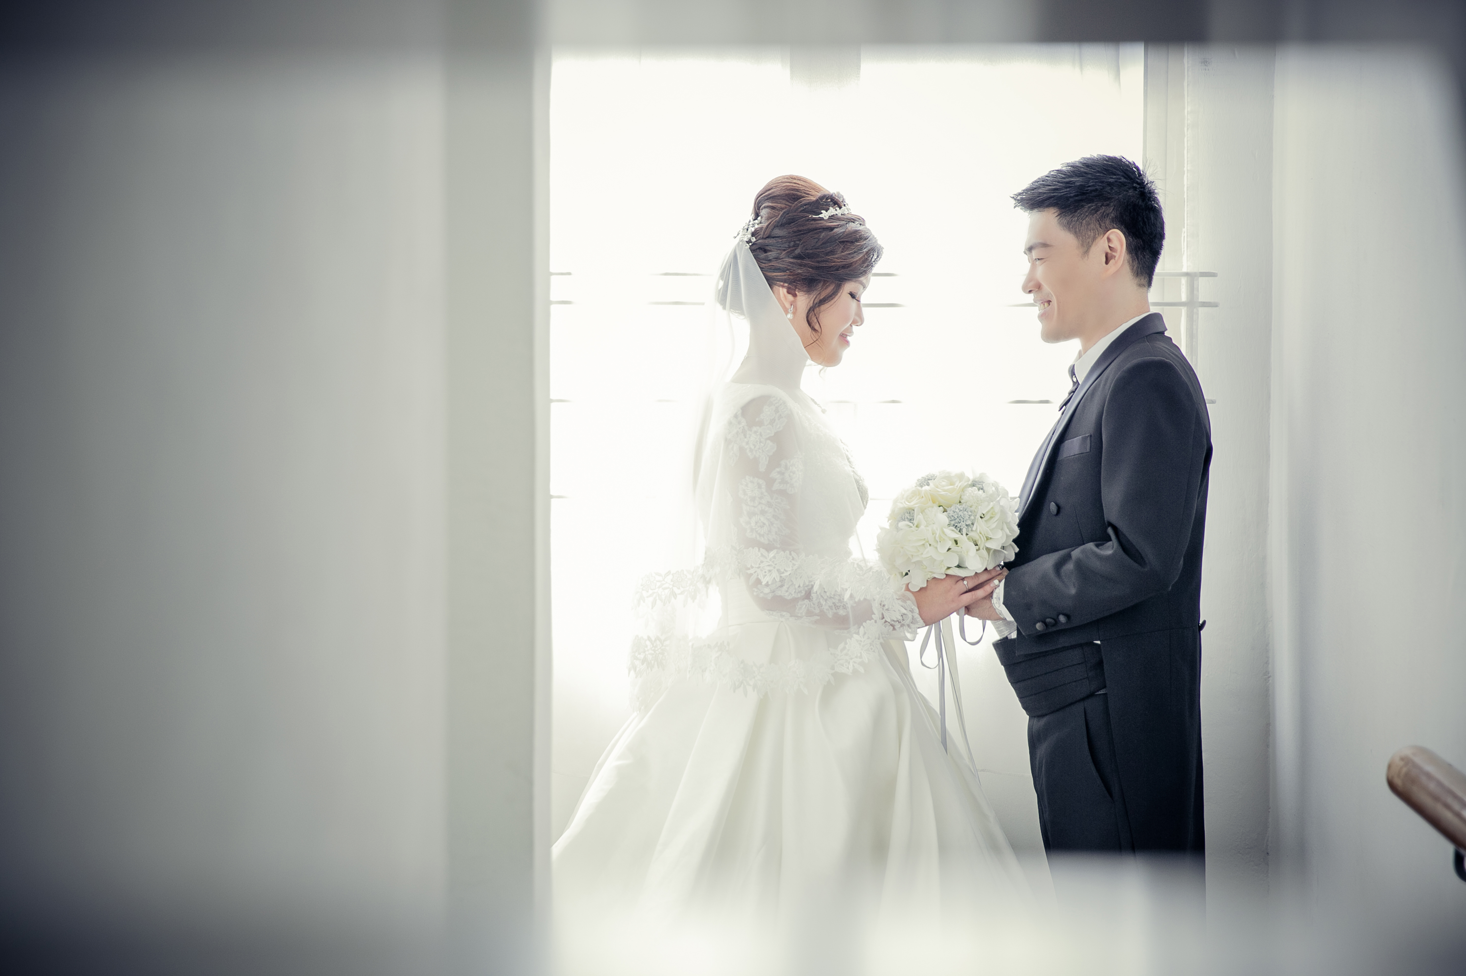
Holy Matrimony of Jason & Win Nie 鸿 翔 与 函 霓 结 婚 典 礼
12 November 2016

Slide 2
Bridal March 婚 礼 进 行 曲

Slide 3
Opening Song
赞 美 诗 歌

Slide 4

Come On And Celebrate
Come on and celebrate His gift of love, We will celebrate The Son of God who loved us And gave us life. We’ll shout Your praise, O King, You give us joy nothing else can bring, We’ll give to You our offering In celebration praise. Come on and celebrate, celebrate Celebrate and sing; Celebrate and sing to the King.

Slide 5

Introduction 介 绍

Slide 6
Praise & Worship 赞 美 与 崇 拜

Slide 7
Hosanna In the Highest
Hosanna, Hosanna,
Hosanna in the highest
Hosanna, Hosanna,
Hosanna in the highest
Lord we lift up Your name
With a heart full of praise
Be exalted, oh Lord my God
Hosanna in the highest

Slide 8
How Great Is Our God
The splendor of a King, clothed in majesty Let all the earth rejoice All the earth rejoice He wraps himself in Light, and darkness tries to hide
And trembles at His voice Trembles at His voice

Slide 9
How Great Is Our God
How great is our God, sing with me
How great is our God, and all will see How great, how great is our God

Slide 10
How Great Is Our God
Age to age He stands And time is in His hands Beginning and the end Beginning and the end
The Godhead Three in One Father Spirit Son
The Lion and the Lamb The Lion and the Lamb

Slide 11
How Great Is Our God
Name above all names Worthy of our praise My heart will sing How great is our God

Slide 12
How Great Is Our God
How great is our God, sing with me How great is our God, and all will see How great, how great is our God

Slide 13
Jesus we enthrone You
Jesus, we enthrone You
We proclaim You, our King
Standing here, in the midst of Us
We raise You Up with our praise
And as we worship,
Build Your throne
And as we worship,
Build Your throne
And as we worship,
Build Your throne
Come, Lord Jesus
And take Your place

Slide 14
Jesus We Enthrone You
And as we worship, Build Your throne
And as we worship, Build Your throne
And as we worship, Build Your throne
Come, Lord Jesus And take Your place

Slide 15
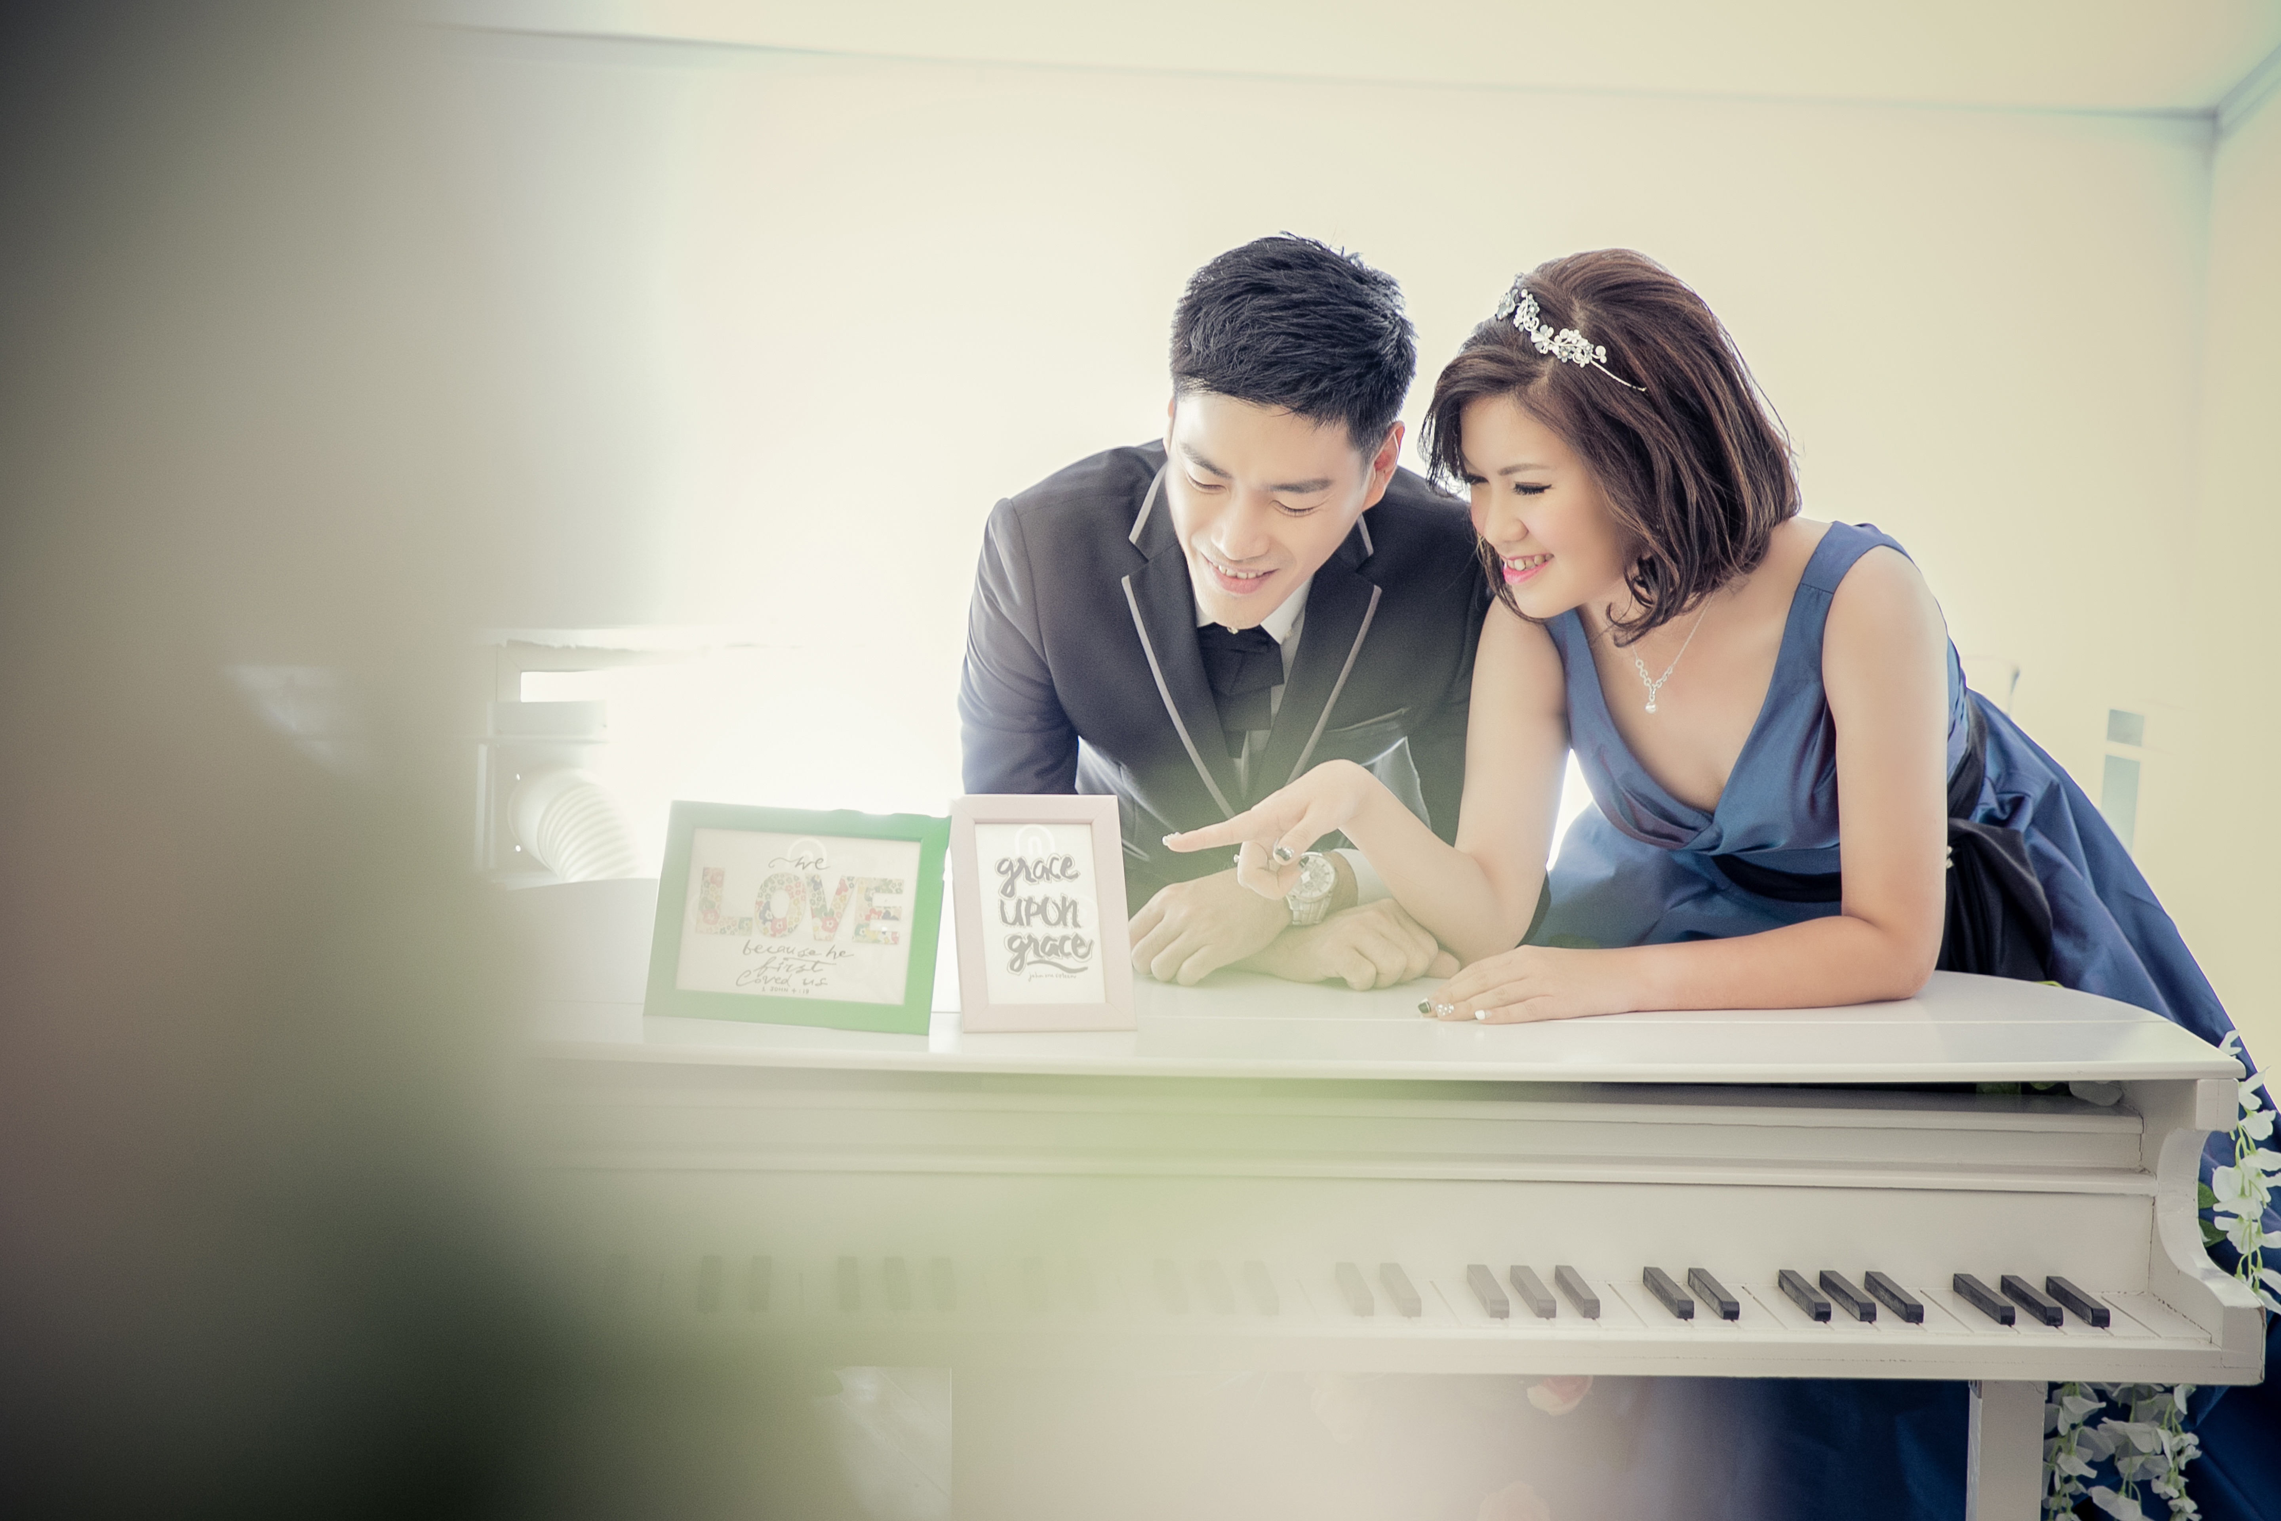
The Blessing of Holy Matrimony 证 婚

Slide 16
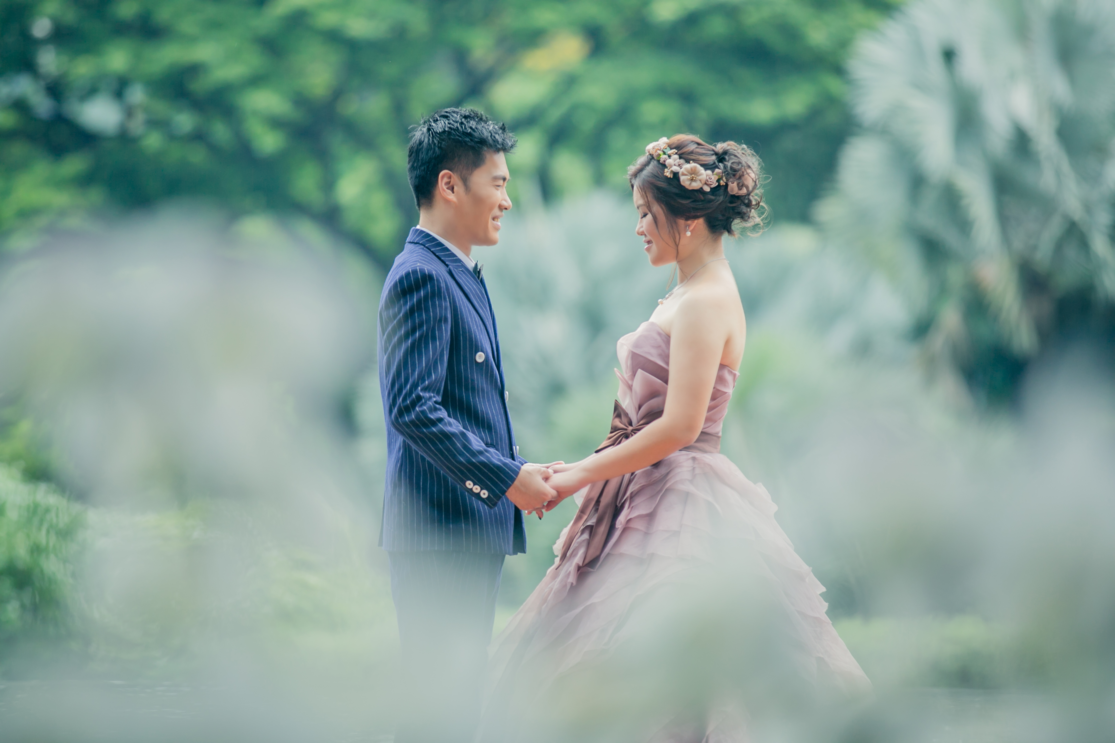
Declaration
宣 示

Slide 17
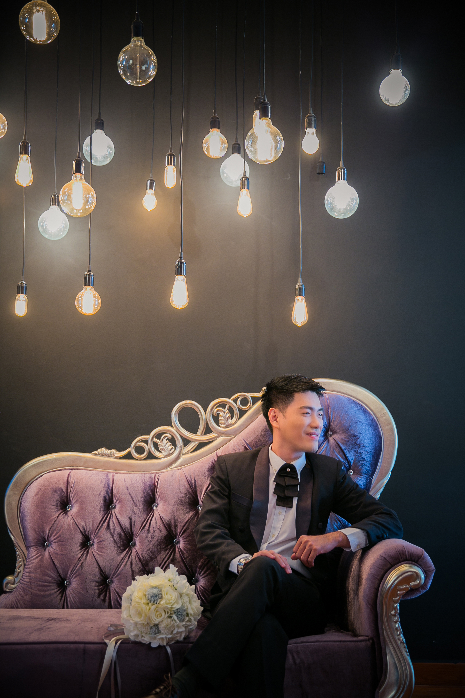
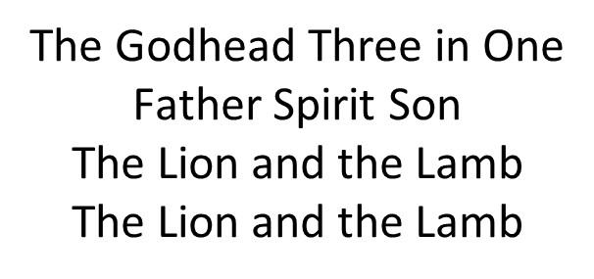
Declaration 宣 示
Pastor : Jason do you acknowledge Win Nie to be your wife? Will you love her and comfort her, honour and protect her, and forsaking all others, be faithful to her as long as you both shall live?
Groom : I will.

Slide 18
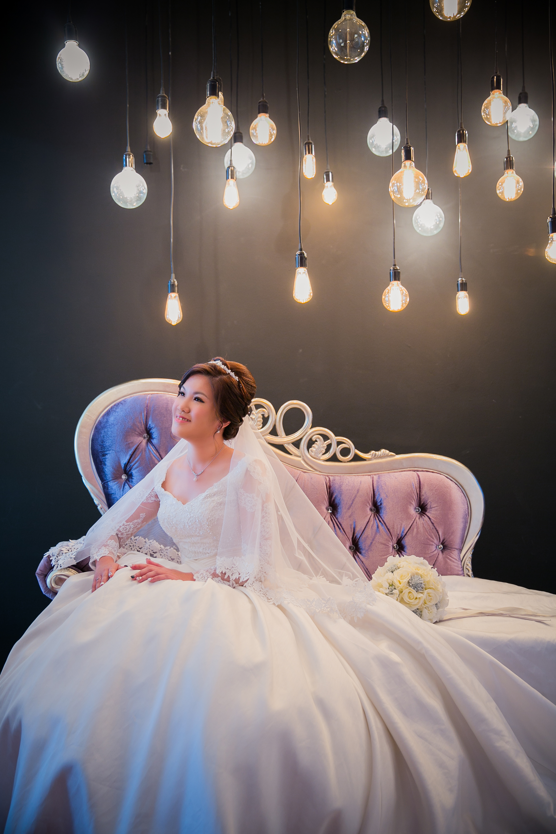
Declaration 宣 示
Pastor : Win Nie, do you acknowledge Jason to be your husband?
Will you love him, comfort him, honour and protect him, and forsaking all others, be faithful to him as long as you both shall live?
Bride: I will.

Slide 19
Marriage Vows
誓 约

Slide 20
Marriage Vows 誓 约
Groom I, Jason acknowledge you Win Nie to be my wife, to have and to hold from
this day forward; for better, for worse, for richer, for poorer, in sickness and
in health, to love, cherish and respect, till death do us part, according to
God’s holy law, and this is my solemn vow.
Bride I, Win Nie acknowledge you, Jason to be my husband, to have and to hold
from this day forward; for better, for worse, for richer, for poorer, in sickness
and in health, to love, cherish and obey, till death do us part, according to
God’s holy law, and this is my solemn vow.
Notes:
If you don’t like it to be two separate slide I will keep this for editing.

Slide 21
Marriage Vows 誓 约
Groom I, Jason acknowledge you
Win Nie to be my wife, to have
and to hold from this day
forward; for better, for worse,
for richer, for poorer, in
sickness and in health, to love,
cherish and respect, till death
do us part, according to God’s
holy law, and this is my solemn
vow.

Slide 22
Declaration 宣 示
Bride I, Win Nie acknowledge you,
Jason to be my husband, to
have and to hold from this day
forward; for better, for worse,
for richer, for poorer, in
sickness and in health, to
love, cherish and obey, till
death do us part, according to
God’s holy law, and this is my
solemn vow.

Slide 23
Exchange of Ring
互 换 信 物

Slide 24

Exchange of Ring 互 换 信 物
Pastor Heavenly Father, by your blessing, let this rings be to Jason and Win Nie a symbol
of unending love and faithfulness to remind them of the vow and covenant which they
have made this day; through Jesus Christ our Lord.
All Amen.
Groom I, Jason give you Win Nie this ring, as a sign of our marriage. With my body I
honour you, all that I am I give to you and all that I have I share with you, and all that
I have I share with you, within the love of God, Father, Son and Holy Spirit.
Bride I, Win Nie give you Jason this ring, as a sign of our marriage. With my body I honour
you, all that I am I give to you and all that I have I share with you, and all that I have I
share with you, within the love of God, Father, Son and Holy Spirit.

Slide 25
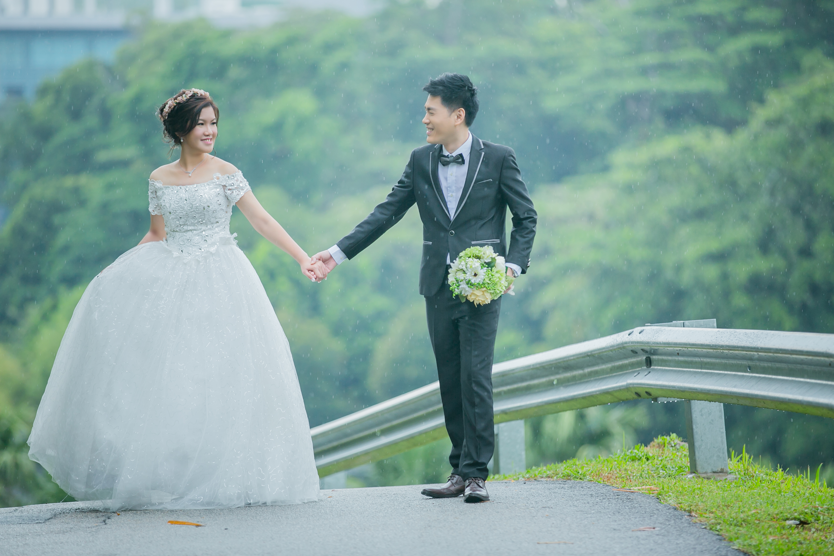
Pronouncement & Benediction
宣 告 与 祝 福

Slide 26
Sermon 讲 道
By: Reverend Chia Kew San (谢牧师)

Slide 27
Scripture Reading
读经 (以弗所书) Ephesians 5:22-28

Slide 28
Ephesians 5: 22-28 (以弗所书 5:22-28)
²² Wives, submit yourselves to your own husbands as you do to the Lord.
²³ For the husband is the head of the wife as Christ is the head of the church, his body, of which he is the Savior.
²⁴ Now as the church submits to Christ, so also wives should submit to their husbands in everything.
²² 你们作妻子的，要顺服自己的丈夫，好象顺服主一样，
²³ 因为丈夫是妻子的头，好象基督是教会的头；基督又是教会全体的救主。
²⁴ 教会怎样顺服基督，妻子也要照样凡事顺服丈夫。

Slide 29
²⁵ Husbands, love your wives, just as Christ loved the church and gave himself up for her
²⁶ to make her holy, cleansing her by the washing with water through the word,
²⁷ and to present her to himself as a radiant church, without stain or wrinkle or any other blemish, but holy and blameless.
²⁸ In this same way, husbands ought to love their wives as their own bodies. He who loves his wife loves himself.
²⁵ 你们作丈夫的，要爱妻子，好象基督爱教会，为教会舍己，
²⁶ 为的是要用水借着道把教会洗净，成为圣洁，
²⁷ 可以作荣耀的教会归给自己，甚么污点皱纹等也没有，而是圣洁没有瑕疵的。
²⁸ 丈夫也应当这样爱妻子，好象爱自己的身体一样。爱妻子的，就是爱自己了。

Slide 30

Prayer for the Groom and Bride
祷 告

Slide 31

Lifting of the veil
掀 开 头 纱

Slide 32
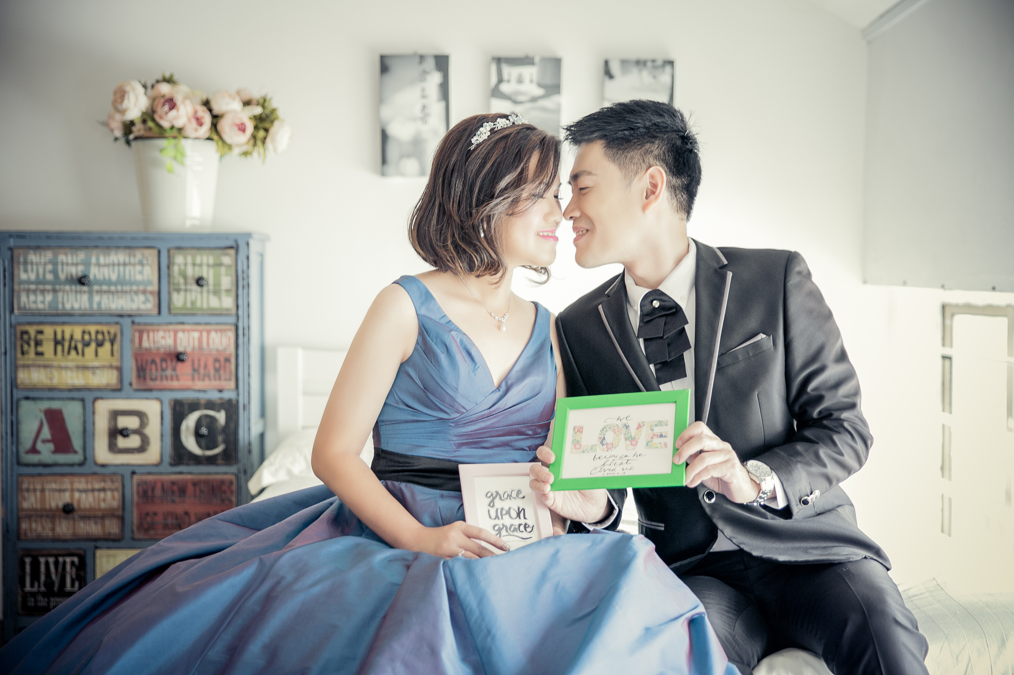
Recessional March
礼 成 乐 曲

Slide 33

Photo Taking
合影留念

Slide 34
Order of Photo Taking
拍照程序
Groom’s Relatives
Bride’s Relatives
Bride and Groom’s Relatives
Groom’s Friends
Groom’s Colleague
Bride’s Friends
Bride’s Colleague
Emmanuel Christian Church
Bride’s Bridesmaid and Sisters
Groom’s Brothers
Bridesmaid, Sisters and Brothers
Dear Guests, please proceed downstairs for your lunch reception after the photo-taking session.
Cake Cutting and thanksgiving speech will take place during lunch
Thank you for joining in our joyous celebration!

